Slide 1
Lists in Python
-Sudheer Suraparaju
Notes:
1

Slide 2
Lists
Like a string, a list is a sequence of values. In a string, the values are characters; in a list, they can be any type. The values in a list are called elements or sometimes items.
There are several ways to create a new list; the simplest is to enclose the elements in square brackets:
Ex: [10, 20, 30, 40]
Ex: [‘crunchy frog’, ‘ram bladder’, ‘lark vomit’]
The first example is a list of four integers. The second Is a list of three strings. The elements of a list don’t have to be the same type. The following list contains a string, a float, an integer, and another list:
Ex: [‘spam’, 2.0, 5, [10, 20]]
A list within another list is nested.
A list that contains no elements is called an empty list; you can create one with empty brackets,[].

Slide 3
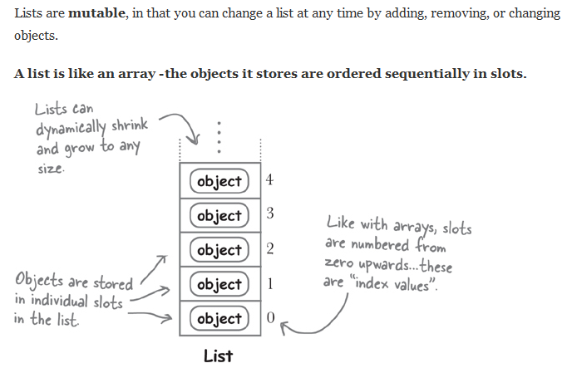
Lists

Slide 4
Lists
As you might expect, you can assign list values to variable:
Ex: cheeses = [‘cheddar’, ‘edam’, ‘clouds’]
Lists are mutable:
The syntax for accessing the elements of a list is the same as for accessing the characters of a string-the bracket operator. The expression inside the brackets specifies the index. Remember that the indices start at 0:
Ex: print cheeses[0]
Cheddar
Unlike strings, lists are mutable. When the bracket operator appears on the left side of an assignment, it identifies the element of the list that will be assigned.
Ex: numbers = [17, 123]
numbers[1]=5
print numbers

Slide 5
Lists
List indices work the same way as string indices:
Any integer expression can be used as an index.
If you try to read or write an element that does not exit, you get an IndexError.
If an index has a negetive value, it counts backward from the end of the list.
Traversing a List:
The most common way to traverse the elements of a list is with a for loop. The syntax is the same as for strings:
Ex: for cheese in cheeses:
print cheese
This works well if you only need to read the elements of the list. But if you want to write or update the elements, you need the indices. A common way to do that is to combine the functions range and len:

Slide 6
Lists
Ex: for i in range(len(numbers)):
numbers[i]=numbers[i]*2
This loop traverses the list and updates each element. len returns the number of elements in the list. range returns a list of indices from 0 to n-1, where n is the length of the list. Each time through the loop i gets the index of the next element. The assignment statement in the body uses i to read the old value of the element and to assign the new value.
A for loop over an empty list never executes the body:
Ex: for x in []:
print “this never happens”
Although a list can contain another list, the nested list still counts as a single element. The length of the following list is 4:
Ex: [‘spam’, 1, [‘Brie’, ‘pol le veq’], [1,2,3]]

Slide 7
Lists
List operations:
The ‘+’ operator concatenates lists:
Ex: A=[1, 2, 3]
B=[4, 5, 6]
C=A+B
print C
[1, 2, 3, 4, 5, 6]
Similarly, the * operator repeats a list a given number of times:
Ex: [0]*4
[0, 0, 0, 0]

Slide 8
Lists
List methods:
“del” is used to remove list elements.
You can access the individual characters of a string present in list.
append:
Appends an element at end.
Ex: fruits = [‘apple’, ‘banana’, ‘cherry’]
fruits.append(‘dates’)
extend:
Extend does same thing as append, it uses iterable and the data elements are flattend.
insert
By using insert we can insert element at a given position.

Slide 9
Lists
Ex: fruits.insert(4,”mango”)
count:
count is used to count number of occurences of an element.
Ex: fruits.count(“mango”)
index
index gives us index of an element.
Ex: fruits.index(8)
fruits.index(“mango”,3)
pop:
pop removes an element from end if we don’t specify the index. And with index it removes that particular element.
remove:
It removes first occurrence of the value and it returns nothing.

Slide 10
Lists
Ex: days = [‘yesterday’, ‘today’, ‘tomorrow’, ‘dayafter’]
for value in days:
print value[:days.index(value)+1].upper()+value[days.index(value)+1:]

Slide 11
Thank you ☺

